Slide 1
Template Design Pattern
Brett Recker
Radwan Albadawi

Slide 2
Story
In software engineering the template method pattern is a behavioral design pattern that defines the program skeleton.
Used to create a GROUP of subclasses that have EXCUTED SIMLUAR group of methods
Serious methods calls that every subclass object will call

Slide 3
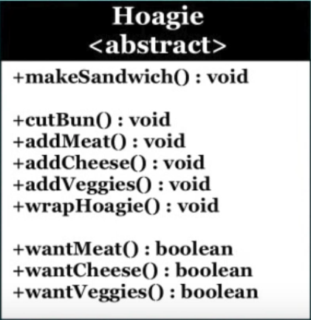
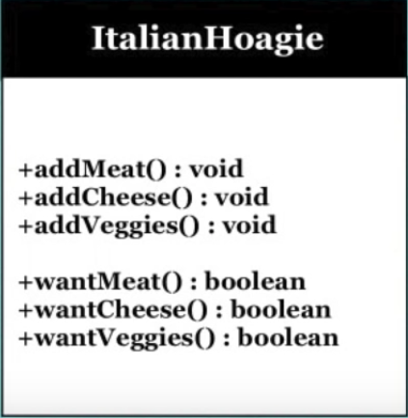
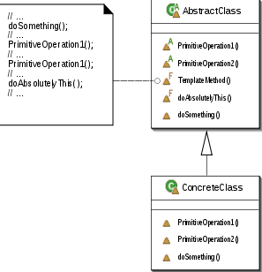
UML Design
Notes:
MakeSandwich() is a template method here, it defined in the abstract class the second example shows more explanation that the template method have some calls the subclass will be using use

Slide 4
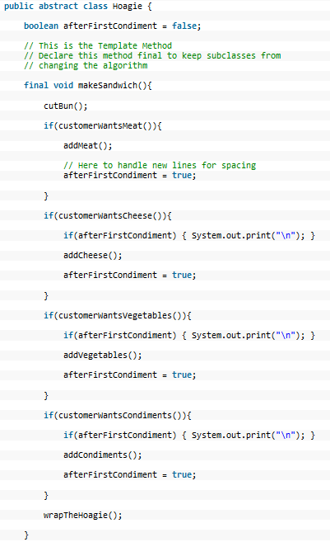
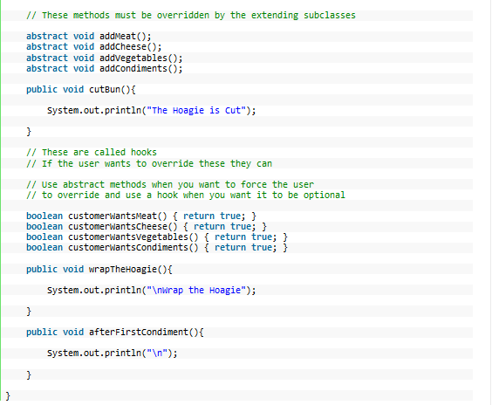
Code

Slide 5
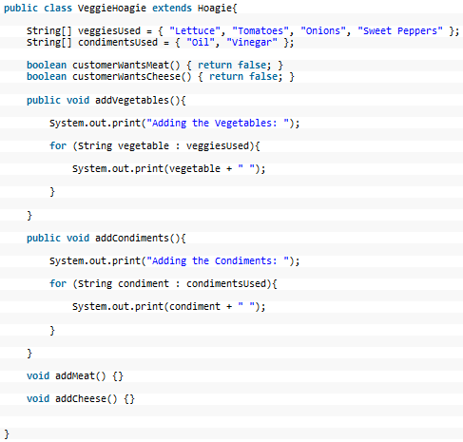
Code

Slide 6
Quiz
The subclass objects can’t override some of the template method calls?
The template method cannot be define in the abstract class?
Why we don’t need template method if the subclasses will not be calling similar calls?
Notes:
False it can override
False we define it in the abstract class.
Because we won’t be using it, the reason of the template method is to be used for a group of subclasses that calling similar calls.

Slide 7
Sources
Template Design Pattern By: Derek Banas @newthinktank.com
Template Method Pattern Wiki

